Slide 1
Google Shopping Training Webinar
Programm – 2020 October

Slide 2
How does Google Shopping
work?
10 min

Slide 3
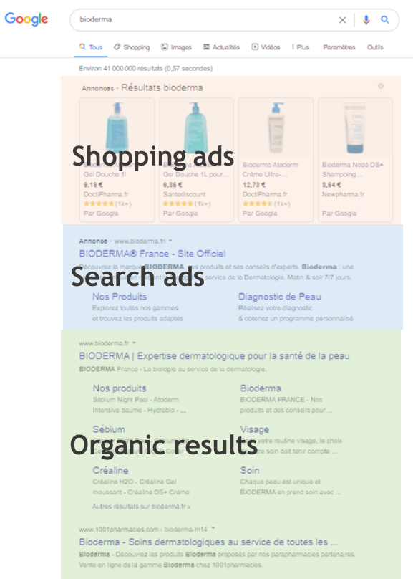
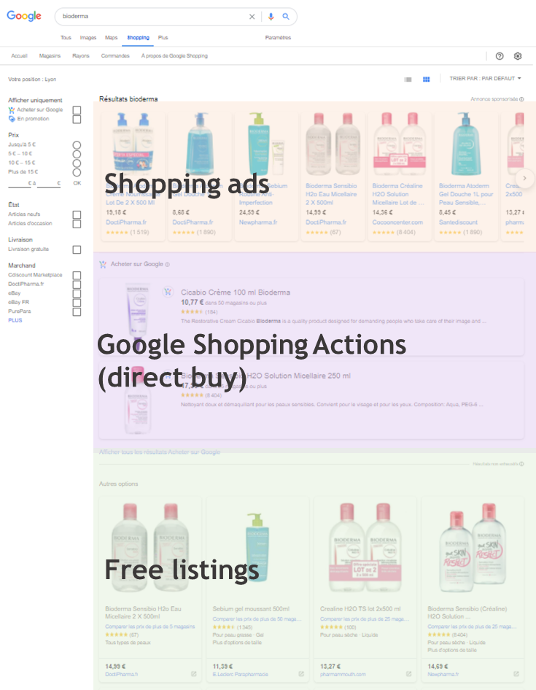
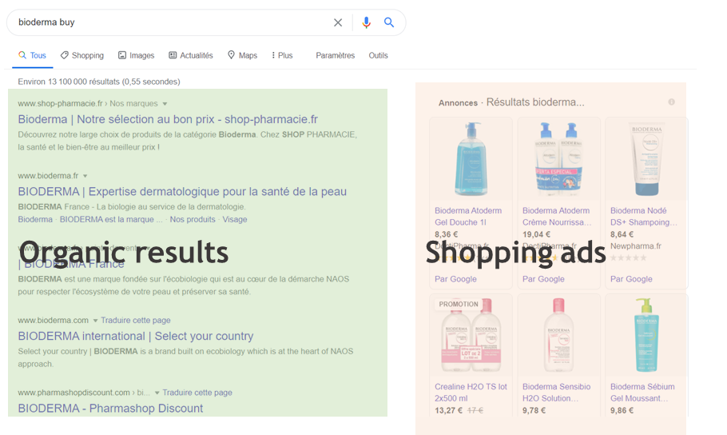
What is Google Shopping ?
Focus on Google Shopping ecosystem
1. SEARCH PAGE RESULTS
2. SHOPPING TAB
Shopping tab is 10% of total click volume

Slide 4
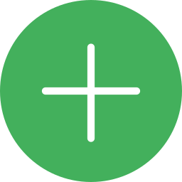
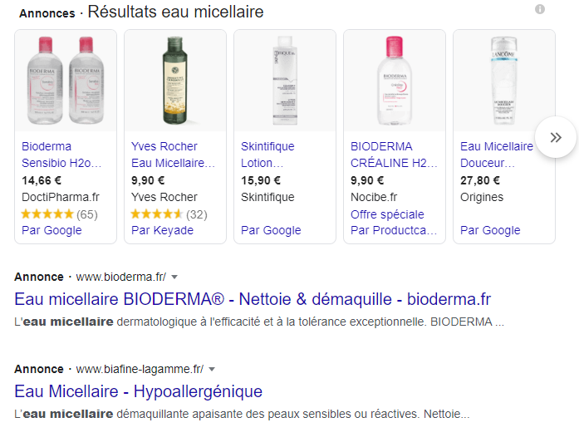
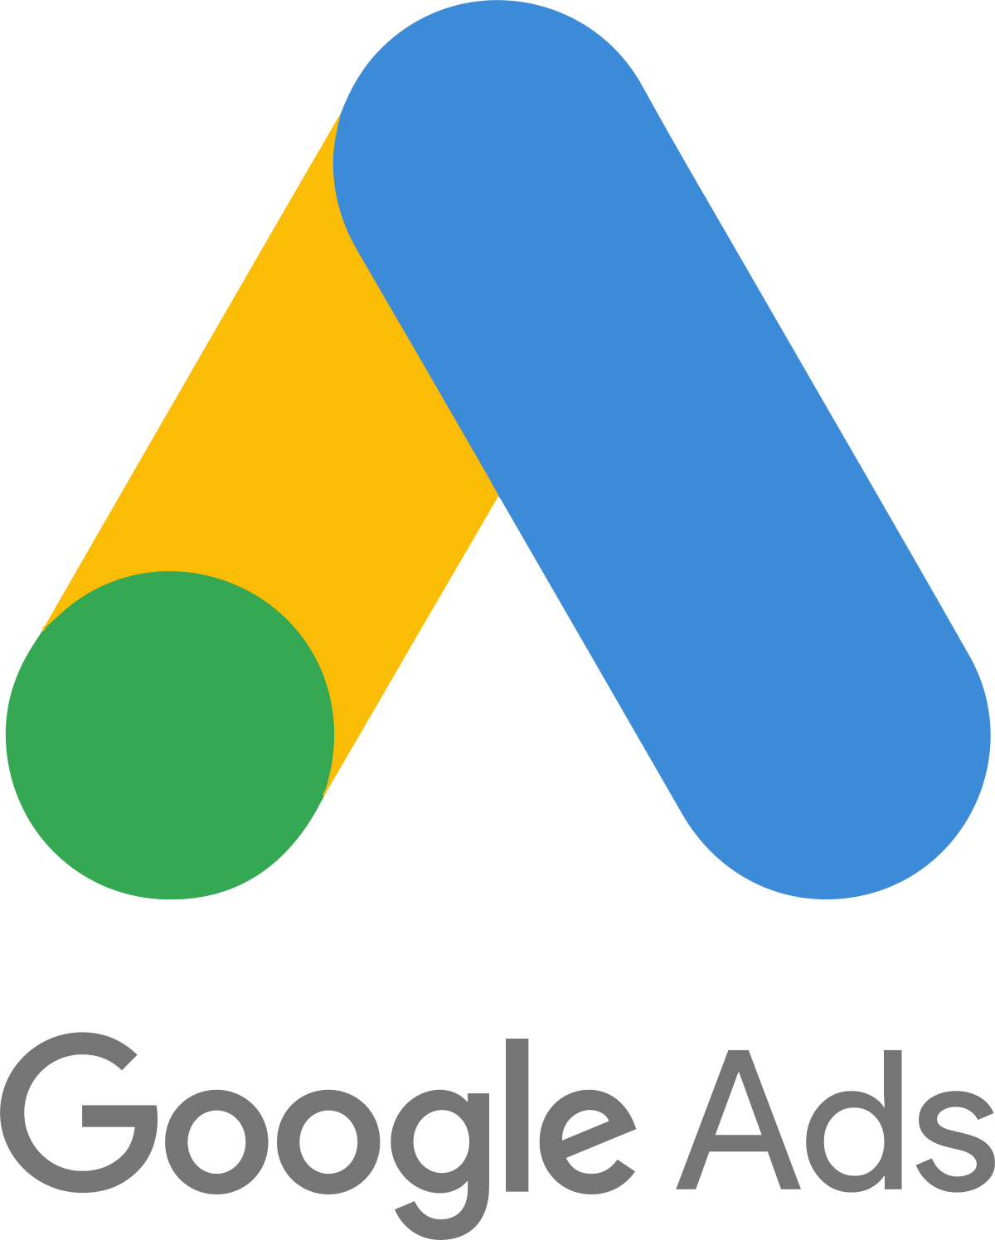
What is Google Shopping?
Google Shopping vs. Google Ads
Keyword: “Micellar water”
Google Shopping results
Rich product information including:
Product title & description
Brand
Image
Price
Retailer
Include product images
Appear on the very top of search results
VS
Google Ads search results:
Textual information
Ads extension
Advertise both product & services
Possible to add extensions to enhance ad

Slide 5
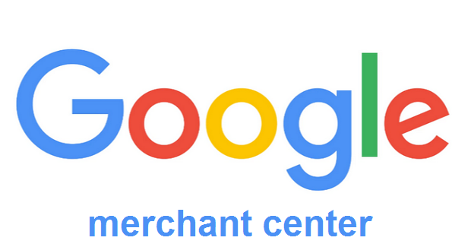
How does Google Shopping work?
Difference between Merchant Center, Google Ads ands Google Shopping Ads
Shopping ad set-up:
Step 1:
Step 2:

Slide 6
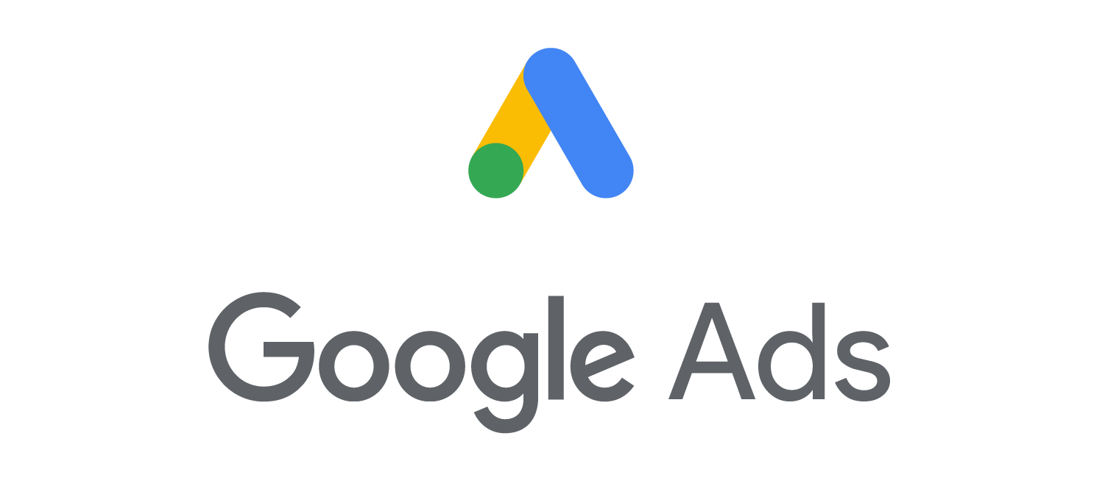
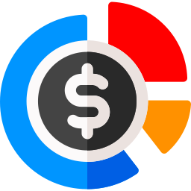
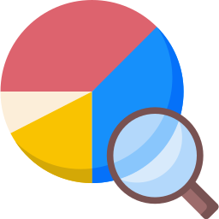
How does Google Shopping work?
The roles of Ads and Google Merchant
Adwords is where you create your Google Shopping Campaign and set all of your targeting options, as you would in any Search Campaign
Merchant Center account is the platform where you upload your information (data feed). Once the products are uploaded, you use Ads to target them
What is this?
Bids/budget
Set and controlled in Google Ads
-
Keywords
No keywords are needed for Shopping Campaigns. The Product’s Description acts as keywords
Detailed product description is required as part of the Data Feed uploaded here
Data Feed Updates
-
Data feeds are uploaded in Merchant Center, and the information is fed into Google Ads
Monitoring
Detailed traffic data (clicks, impressions, conversions, etc.) would show in Google Ads
Limited information on “Paid Cliks” shown in the Product overview of the Merchant Center

Slide 7
When should we start Google Shopping campaigns?
20 min

Slide 8
Google Shopping campaigns management
2 case scenarios
Case 1
own
e-commerce
Case 2
via
e-retailers
8

Slide 9
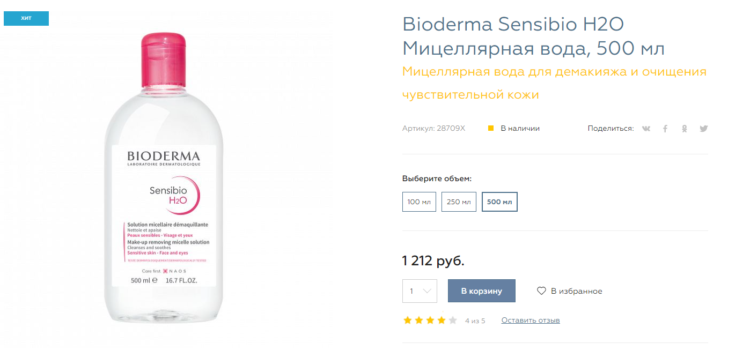
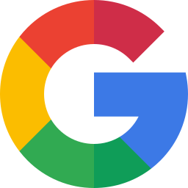
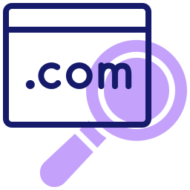
Our focus today ☺
Google Shopping campaigns management
Own e-commerce
You own D2C website (NAOS, Esthederm, Etat Pur…)
When you can sell directly from your website, redirect your Google Shopping campaigns directly to your product page.
You are in the typical case of a Google Shopping campaign.
Shopping
Campaigns
E-commerce
Product page
CTA
Buy the product
Consumer journey
9

Slide 10
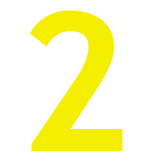
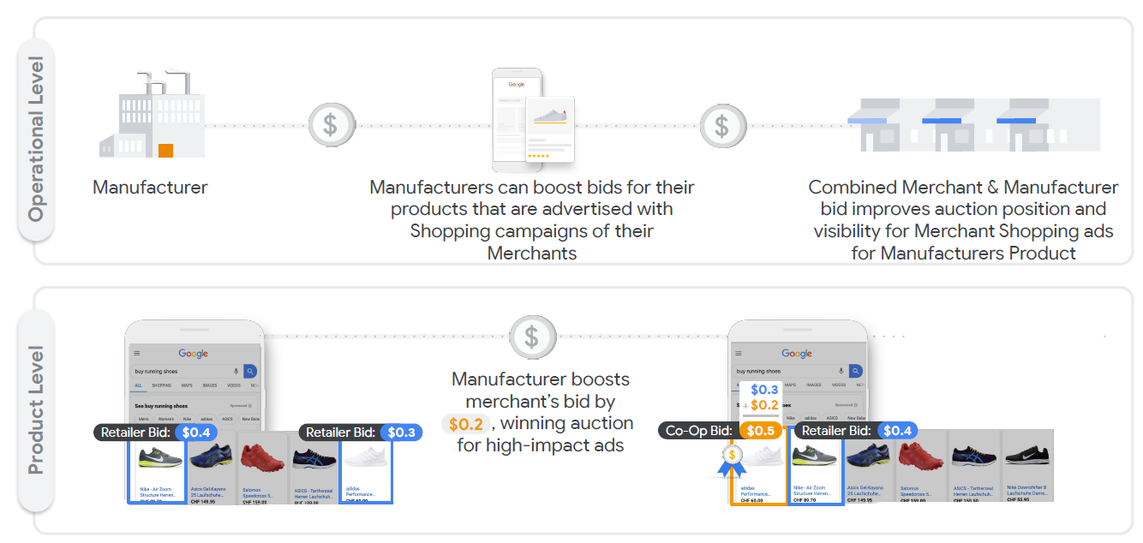
Google Shopping campaigns management
Beta version
Shopping campaigns with Partners
Google Shopping via e-retailers
As a brand, you have the opportunity to boost the visibility of your products on Google Shopping via your various merchants and e-retailers.
This is the 'Shopping Campaigns with partners' service, or before 'Co-funded ads'.
This service gives you the possibility to :
- Share your Google Shopping campaign costs with your e-retailers
- Commonly increase the sales of your products
- Giving more visibility to the e-retailers you trust
- Analyse more precisely the impact of your e-retailers on sales
How does it work?
10

Slide 11
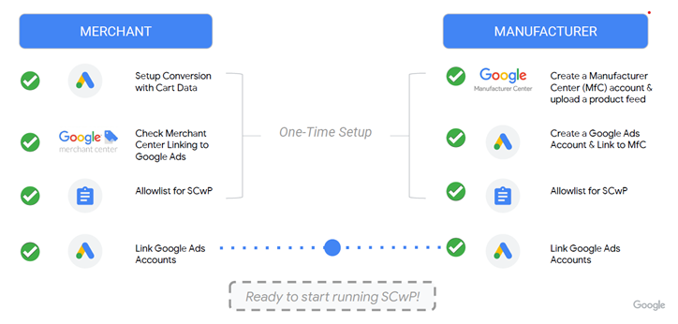
Google Shopping campaigns management
Beta version
Shopping campaigns with Partners
Pre-requisits to run Shopping campaigns with partners
Set-up process:
Needs to be set-up on Partner side
Needs to be set-up on Brand side
More information about beta: https://www.google.com/retail/solutions/shopping-campaigns-with-partners/
11

Slide 12
Google Shopping campaigns management
Focus on Trademark protection
What about e-retailers that run campaigns for your brand? Can you protect your trademark on Google Shopping?
No.
Unlike Search Google Ads campaigns, Shopping ads don’t restrict use of trademarks by merchants in the title or description of an ad when it’s for a trademarked product or a product compatible with the trademarked product.
Google reviews claims by trademark owners that use of their trademark is likely to cause consumer confusion about the origin of a product.
12

Slide 13
How to manage
Merchant Center campaigns with best conditions?
45 min

Slide 14
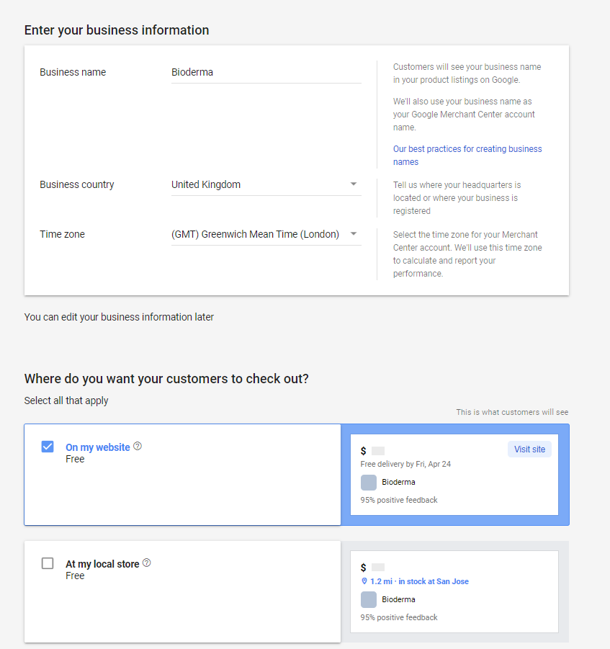
How to manage Merchant Center campaigns?
Creating your merchant account
Create your merchant account
First access the Google Merchant Center home page.
You will need to indicate whether you are promoting your website or your local store. One will take the data from your site, the other from your Google MyBusiness page.
Google may also offer to fill in your Shopify or Paypal details directly. This feature will allow you to offer a direct purchase on Google Shopping (Google Actions).
We recommend that you do not select one of them, it is important that the user does not make his journey only on the Google tool.
When you create your account, you are also offered to choose between "On my website" and "At my local store". "At my local store" allows you to promote products directly in store.
-SEM WEBINARS-
2020 October
14

Slide 15
How to manage Merchant Center campaigns?
Manage Google Shopping campaigns: Different steps
Set up your Merchant Center Account
Sign up for Shopping Actions by selecting it when you sign up for Merchant Center, or click Growth in the left navigation menu, then Manage programs.
Select Shopping Actions from the list of available programs.
You can stop and start setup at any point. Once you’ve started setup, Shopping Actions will automatically be added to your list of pending tasks in the Overview screen.
Set-up process:
1
2
3
Linking Adwords account
Add
your products
Provide your
website
6
5
4
Provide promo.
information
Set up your campaign
Set up your tax
and shipping
-SEM WEBINARS-
2020 October
15

Slide 16
How to manage Merchant Center campaigns?
Linking your Adwords account
Link your Merchant Center and Google Ads account
To link to your own Google Ads account:
In your Merchant Center account, click the tools icon and then click Linked accounts under "Settings".
Select Google Ads.
Under “Your Google Ads account,” find the Google Ads customer ID of the account you want to link.
Click Link under "Actions".
When you approve a link between your Google Ads and Merchant Center accounts, you'll allow your product data to flow from Merchant Center to Google Ads for use in advertising campaigns.
Only a Merchant Center account user can request to link the accounts
Once the Google Ads account owner approves the request, some information is shared between accounts.
Google Ads account owners and either admin or standard Merchant Center users can remove the link at any time.
If you remove the account link, Shopping campaigns that rely on product data from this Merchant Center account will stop serving ads.
-SEM WEBINARS-
2020 October
16

Slide 17
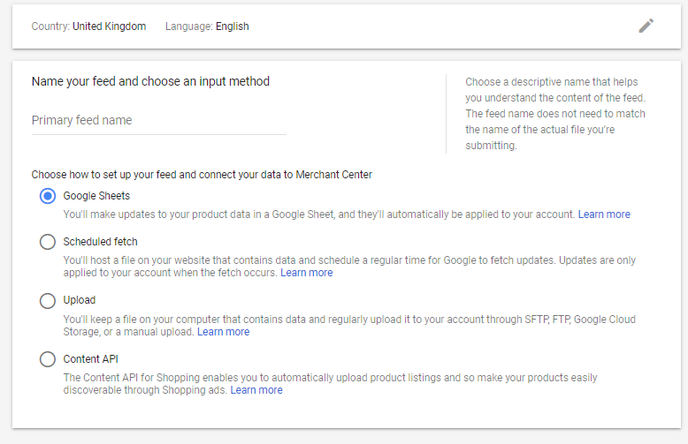
How to manage Merchant Center campaigns?
Add your products: Create your data feed
2 ways: Add products
To import your products on Google Merchant Center, two methods are available
Individual
=> Enter one product at a time. You can make changes to the product data later.
Multiple product (recommended)
=> Create a feed to add large quantities of products. You can upload products using tools like direct files or the content API (host file, PIM, external tool...).
To fully understand how Google Shopping works, we will start in our case on a Google Sheet / file upload.
For reasons of simplicity, it is preferable to use the "Scheduled fetch" method to keep a single and updated file.
-SEM WEBINARS-
2020 October
17

Slide 18
How to manage Merchant Center campaigns?
Add your products: Create your data feed
Our case: Upload products with a spreadsheet
Filling guidelines: 1st raw (header) => include the attribute names separated by a tab 2nd raw & so on => include the corresponding values under each attribute name
Tools to use:
We recommend using a spreadsheet program such as Microsoft Excel or Google Sheets to create this and save the file as a tab-delimited file.
If you’re using Google Sheets, you can download your file and upload it as a .txt file or upload your spreadsheet directly to Merchant Center.
Advantages:
Simple to create and edit if you have a spreadsheet program
Easier to view multiple items
Disadvantages:
Easier to make formatting mistakes
File update:
You can upload a first version of your feed and then readjust it through other uploads. Google will offer you to compare the two.
-SEM WEBINARS-
2020 October
18

Slide 19
How to manage Merchant Center campaigns?
Add your products: Create THE Primary feed
Primary feed
A primary feed is the required data source that Merchant Center uses to display your products on Google.
For example, the primary feed:
Supplemental feeds
Supplemental feeds provide additional, or supplemental, data that can be connected to existing product data in the primary feed.
Supplemental feed that uses the id attribute to match to the primary feed.
id | title | price | brand
1 | shirt | 34 | Brand A
2 | shoes | 55 | Brand B
3 | hiking boots | 100 | Brand C
4 | pants | 75 | Brand A
id | custom_label
1 | SALE
4 | SALE
The attributes "title", "description" and "visual" have a direct impact on the positioning in the results.
Resulting feed:
id | title | price | brand | custom_label
1 | shirt | 34 | Brand A | SALE
2 | shoes | 55 | Brand B
3 | hiking boots | 100 | Brand C
4 | pants | 75 | Brand A | SALE
-SEM WEBINARS-
2020 October
19

Slide 20
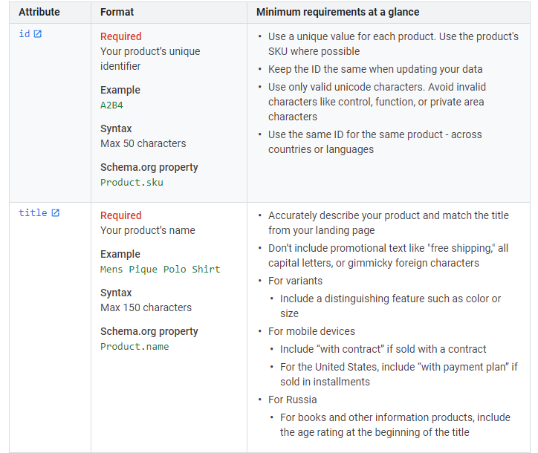
How to manage Google Shopping campaigns?
Add your products: Product data attributes
Example:
The product data specification provides guidelines for submitting high quality data to Google.
Fresh, comprehensive, and accurate product data will help attract users to your products.
Some best practices to avoid common data quality violations include:
Provide clear and conspicuous pricing information.
Provide the freshest availability status of your items.
Provide complete and correct shipping information and costs.
Show a product that is essentially identical on your landing page to the product data you submit to Google.
You can find here, all the specifications to enter to feed your products in Google Shopping.
-SEM WEBINARS-
2020 October
20

Slide 21
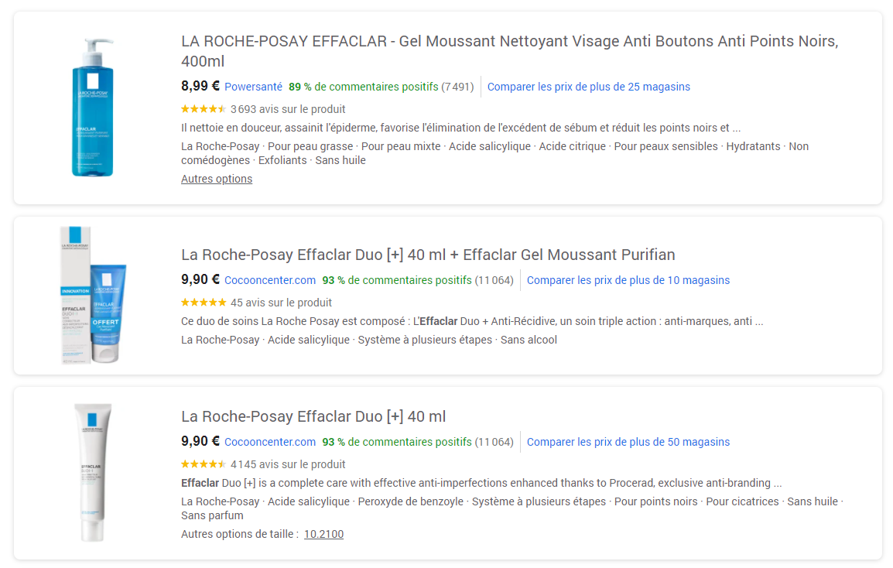
How to manage Merchant Center campaigns?
Add your products: Correctly setting your title attribute
title: The most important attribute
Use the title attribute to clearly identify the product you’re selling. The impact on positioning is very important.
The title is one of the most prominent parts of your ad or free listing. A specific and accurate title will help us show your product to the right users.
Required for each product.
Limits: 1-150 characters
Best practices:
Use a relevant title that clearly describes your product.
Describe the product shown on your landing page.
Distinguish between variants.
Add the distinguishing details of each variant to the title.
Be specific.
Use professional and grammatically correct language.
Don’t use words from foreign languages, unless they’re well understood such as a product with a foreign name or title.
"Do" - Clear title, Brand and product name, gives additional information on product specifications
"Don't" - Don't give information on the usefulness and specificities of the product
-SEM WEBINARS-
2020 October
21

Slide 22
How to manage Merchant Center campaigns?
Add your products: Optimizing the description field in your product feed
description: An attribute to define the specifics of your product
Use the description attribute to give more information on the specifics and peculiarities of your product.
Required for each product
Limits: 1-5000 characters
Best practices:
Describe only the product itself. Don't describe other aspects like details about compatible products, accessories, other similar products available.
Use professional and grammatically correct language.
Don’t use words from foreign languages.
Don’t include comparisons or details about other products.
Don’t include references to categorization systems.
Don’t include links to your store or other websites.
Don’t use capital letters for emphasis.
Don’t include promotional text.
"Do" - Clear, well-structured description, giving information on all the specifics and the care provided.
"Don't" - Provides only branded speech and little explanation
-SEM WEBINARS-
2020 October
22

Slide 23
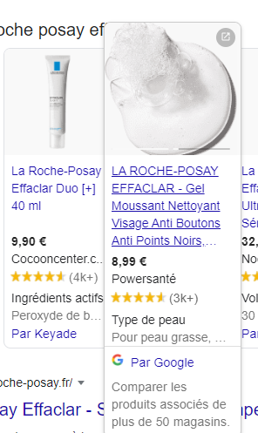
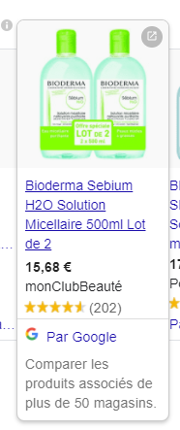
How to manage Merchant Center campaigns?
Add your products: Focus on image link
"Do" - Use multiple images to describe your product: close-ups, textures, key properties...
Image_link: An attribute to define your product image
This attribute include the URL for your main product image.
This image appears to potential customers in ads an dree listings for your products.
To feed this attribute, it is necessary that your product visuals are hosted on your server.
We strongly recommend that you use the links of your visuals on the product page.
Warning: your image folders should not be blocked in the robots.txt file.
"Don't" - Use images that are very hard to read or that don't provide essential information about the product
-SEM WEBINARS-
2020 October
23

Slide 24
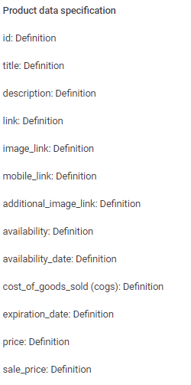
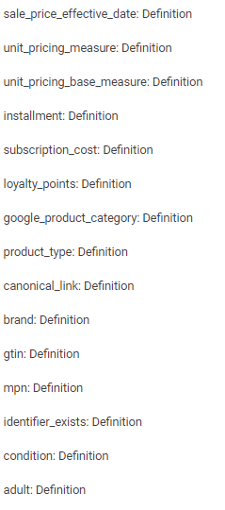
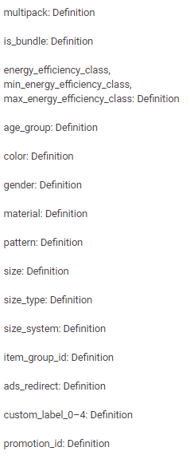
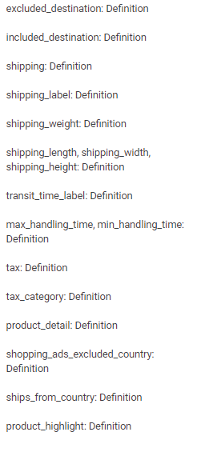
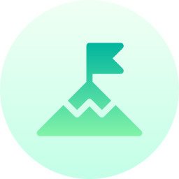
How to manage Merchant Center campaigns?
Add your products: A large number of attributes available
10 most important attributes
You can find here, all the specifications to enter to feed your products in Google Shopping.​
-SEM WEBINARS-
2020 October
24

Slide 25
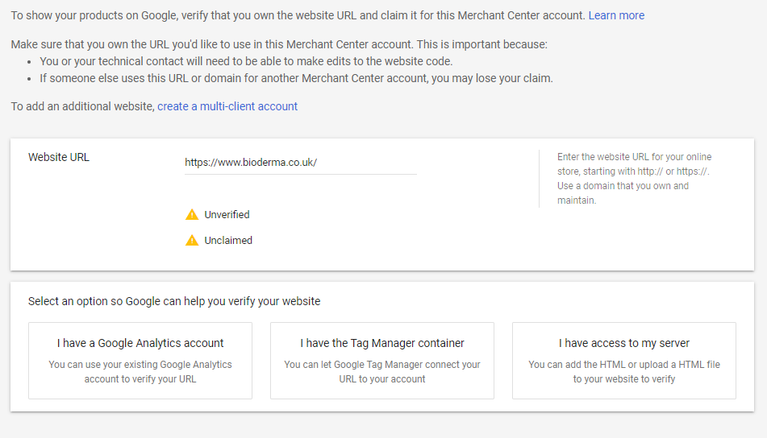
How to manage Merchant Center campaigns?
Provide your website: Define the URL
Verify your website
You can validate a website URL at any time by doing the following:
Login to your Merchant Center account.
On the navigation menu, click the Tools icon .
In the "Tools" section, select Company Information.
Click the Website tab.
Enter the URL of your online store, starting with "http://" or "https://". Use a domain that you own and manage.
Click Save.
To validate your account, you can use:
An existing Google merchant center account
An existing Google tag manager linked to your website
An HTML file to put on your website server
-SEM WEBINARS-
2020 October
25

Slide 26
How to manage Merchant Center campaigns?
Manage Google Shopping campaigns: Different steps
Linking Adwords account
Add
your products
Provide your
website
Provide promo.
information
Set up your campaign
Set up your tax
and shipping
-SEM WEBINARS-
2020 October
26

Slide 27
How to manage Merchant Center campaigns?
Set up your tax and shipping
Tax setting - required
So that users understand exact price that they’ll have to pay for a product, you may need to submit the taxes that you collect. Because tax can be a complex subject, you have several different options for submitting tax:
Don’t set up taxes
Submit taxes correctly for your target country
For US or different taxes for the same country, determine the states in wich you charge tax
Shipping setting - required
When submitting your products to Merchant Center, you’ll also provide information about how much you charge for shipping.
Your shipping settings are used
across Google programs, including
Shopping ads, surfaces across
Google, and Shopping Actions.
You have different options to set up shipping:
Free shipping for certain ranges
A flat shipping rate for all orders
Your shipping rate for all orders
Your shipping is based on rates form supported carriers
Based on a percentage of the order cost
Unique shipping costs for one particular product
Exclude a group of products from delivery in a shipping service
Shipping cost is the most common reason for users abandoning their shopping choices, so you’ll want to be sure your shipping settings are accurate and up-to-date.
-SEM WEBINARS-
2020 October
27

Slide 28
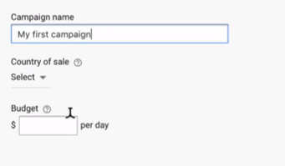
How to manage Merchant Center campaigns?
Create your campaign: set up campaign in Google Ads
Create your campaign
Shopping campaigns use product groups to select which products you want to bid on for a given campaign.
You can sub-divide your inventory into customized product groups using any product attributes (such as category, product type, or brand) and at any level of granularity.
The products within the product groups you don’t subdivide remain in an “Everything else” product group. You then set bids for each product group depending upon your campaign goals.
You’ll need to create campaigns for your Shopping ads in Google Ads in order to advertise your products. Shopping campaigns allow you to manage, organize, and optimize Shopping ads.
-SEM WEBINARS-
2020 October
28

Slide 29
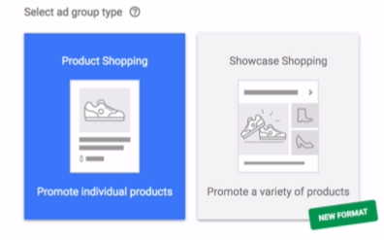
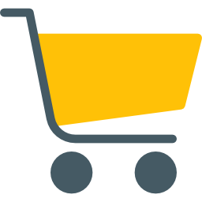
How to manage Merchant Center campaigns?
Create your campaign: structure your campaign
My Client Center
Account 1
Account 2
Campaign 1
Campaign 2
Ad Group 4
Ad Group 1
Ad Group 2
Ad Group 3
Products
Products
Products
Products
Campaign 3
Wich structure for your campaign?
Account => Account associated with your brand / domain name.
Campaign => A set of ad groups (ads, products) that share a budget, location targeting, and other settings. Campaigns are often used to organize categories of products or services that you offer.
Ad Group => An ad group contains one or more products that share similar targets.
Ads => Text content displayed to the user during a query on Google.
Products (or showcase shopping) => Targeted products on which an ad should appear.
2 main ad formats:
-SEM WEBINARS-
29

Slide 30
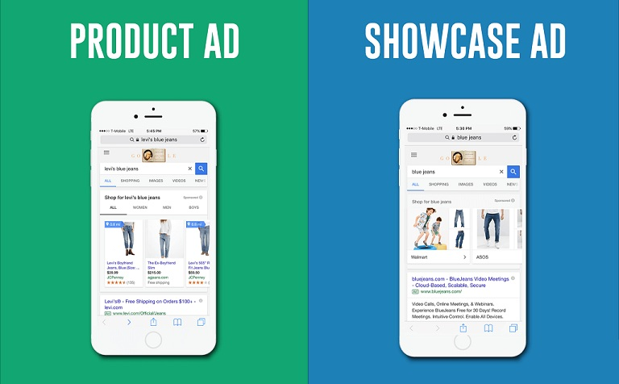
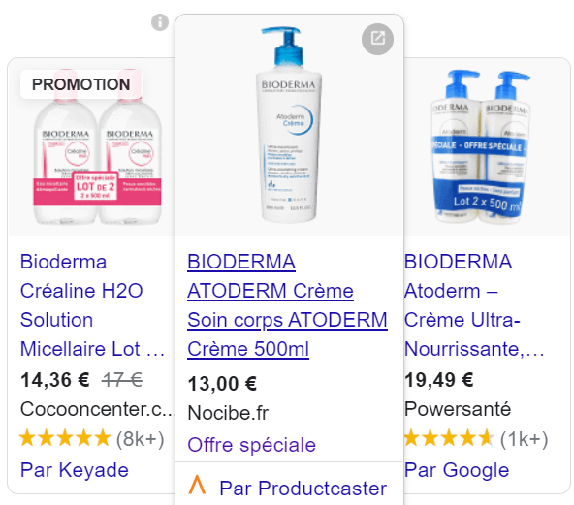
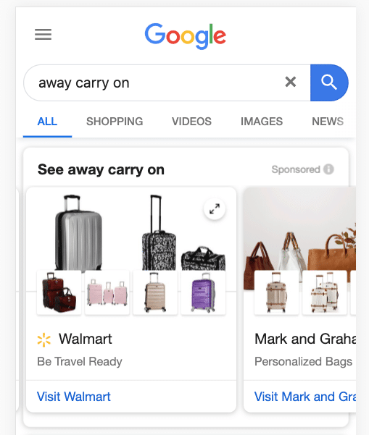
How to manage Merchant Center campaigns?
Create your campaign: Shopping ad types
Product ad
This classic format that focuses on one product / set and its key attributes.
Google Showcase
This format offers rich content that will allow you to present an ad with 3 product visuals, a main image and two small secondary images. Cross selling.
Available in 94 countries. Click to see supported countries list
Available in these countries:
-SEM WEBINARS-
2020 October
30

Slide 31
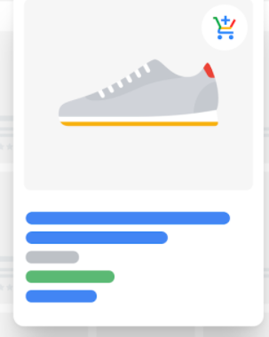
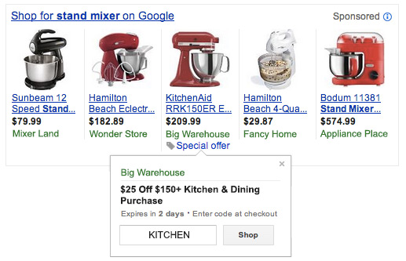
How to manage Merchant Center campaigns?
Create your campaign: more extensions for your products
Google Actions
Google Actions allows you to sell your products directly on Google. You only pay when you register a sale (commission).
Google Promotions
This feature allows you to distribute your online offers via your Shopping Ads on Google.com.
When you add promotions to the products you sell on Google, a "special offer" link is displayed (e.g. 15% discount, free shipping, etc.).
-SEM WEBINARS-
2020 October
31

Slide 32
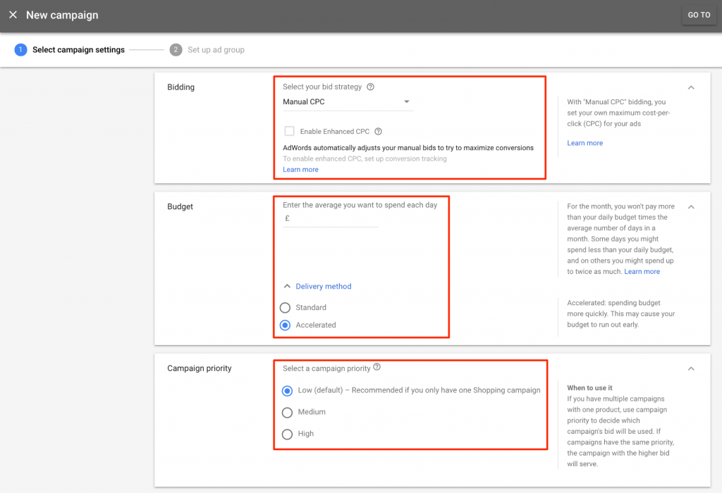
How to manage Merchant Center campaigns?
Create your campaign: bid and budget
Determining your bid and budget
Determine your cost-per-click (CPC)
Your CPC bid, or max CPC, is the maximum amount you are willing to pay when someone clicks on your ads.
There are two basic steps to strategic bidding:
Identify how much your products cost in comparison to how much revenue they bring in.
Adjust your bids to maximize your return on investment.
Determine your daily budget
Choose a daily budget based on your advertising goals and the general amount you're comfortable spending each day.
If you're working with a monthly advertising budget, find your daily budget by dividing your monthly budget by 30.4 – the average number of days per month.
Focus on Smart shopping option
Smart shopping is easy to set up and it shows your ads across many ad platforms Google has – not just when new clients are searching.
We’d recommend experimenting with it a separate campaign to see if gets your results.
-SEM WEBINARS-
2020 October
32

Slide 33
How to measure my results and optimize
my performances?
15 min

Slide 34
How to measure and optimize my performances?
How to effectively measure my Ads performance?
Measure my Google Ads performances
If you work with an agency or if you optimize your Google Shopping campaigns yourself, you need to know where you can improve your campaigns.
In paid referencing, as in natural, it is important to constantly analyze key performance indicators (KPIs) to determine how your campaign are positioned in relation to your investment and identify the weak points (title, description, image, bid…) in order to make the appropriate adjustments.
There are two practices to follow for a good Google Shopping performance measurement:
Campaign monitoring – Google Ads (and not in Merchant center)
WebAnalytics performance monitoring - Google Analytics
Campaign monitoring
Budget and CPC evolution
Performance of different ads group
Conversions
WebAnalytics monitoring
Acquisition from Shopping campaigns
Contents consulted
Engagement of your users (content and conversion)
34

Slide 35
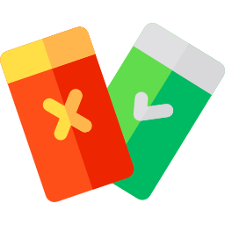
How to measure and optimize my performances?
10 golden rules to optimize your Google Shopping campaigns
4. Top vs. Other ​
Apply the "Top versus Other" segment to your statistics tables to find out where your ad appeared on Google's search results pages and search partners' pages.
Segmenting your data by “Top vs. other” can help you to optimize your search campaigns to display your ads on the parts of the page that perform best for you.
5. Find your winners and losers
It is difficult to finely impact Google Shopping positioning. In spite of a good optimization of your title and description, you will see that some products do not go up well.
These are the "losers".
In this case, it is important to prioritize the "winners" in order to spend your budget wisely.
1. Optimize your product feed
2. Optimize your campaign structure
3. Divide products into ad groups
35
Notes:
1 & 2 Optimize your set up
Assist Google Ads in finding what products you think are the best to advertize on and get creative with the type of campaign that you run.
4. : A Top vs. Other Report gives insight on the frequency of where an ad is located on the SERP, either in the top area above the search results or in other areas (side/bottom) on the SERP

Slide 36
How to measure and optimize my performances?
Ten rules to optimise your Google Shopping campaigns
6. Exclude unprofitable products​
7. Add negative keywords​
While Shopping campaigns don't use keywords to target your ads, you can use negative keywords to help prevent your Shopping ads from appearing when you don't want them to.
8. Sub-divide negative keywords​
9. Bid adjustments ​
10. Don't make drastic changes
As seen previously, it is complex to have a significant impact on the positioning of your ads.
It is therefore essential not to make drastic changes and to follow a controlled test & learn logic.​
36
Notes:
6. Set a return on ad spend (ROAS), conversion or revenue goal.
9. You’ll be able to review and edit the bids set for any new product groups you create

Slide 37
How to measure and optimize my performances?
Compare your Google Shopping ads with the competition
Google Shopping ads give the users that information they most want to see: visual ads for a specific product.
Visual
Identify immediately the product the users are looking for. Chose the right picture in high quality.
Titles
Make sure they are attractive, relevant and search engine friendly.
Rating and reviews
Provide high quality reviews and send all of them regularly to take advantage of Google Seller Ratings.
Placement
Make sure that you submit as you can in the feeds in Google Merchant center to make sure Google matches your products to the right user, search terms and queries.
Landing pages
Make sure your landing pages match your ads and leads to the e-commerce funnel easily.
Description
They are extremely relevant for user experience and click-through rate (CTR). Your product descriptions can help you stand out among your competitors.
Price
Compare the options. You can also create promotions.
37

Slide 38
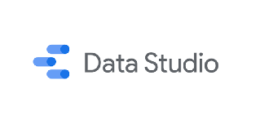
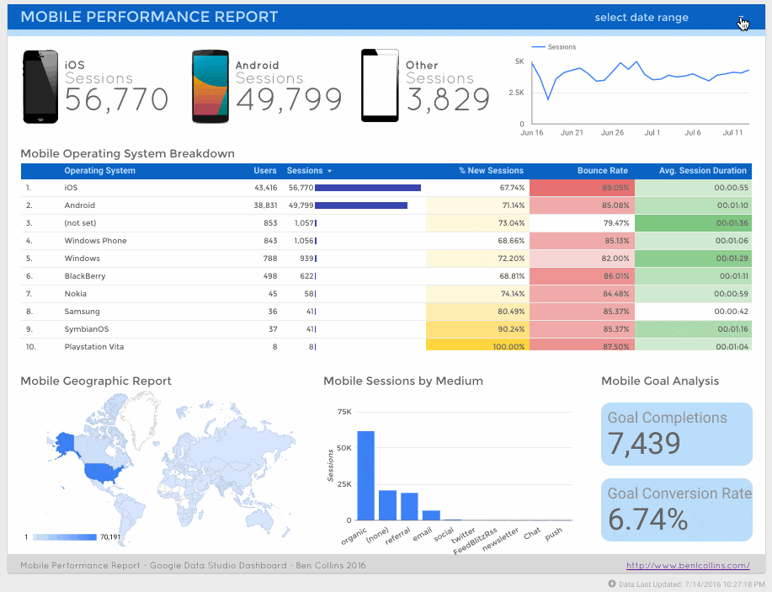
How to measure and optimize my performances?
Focus on performance monitoring: Google Data Studio
GDS is an online (cloud solution) and real-time data visualization and reporting tool. It also allows the aggregation of several data sources.
Within the dashboards, you will be able to add Google Shopping indicators from both Adwords account and Google Analytics. For example :
Impressions
Average CPC
Conversion rate
…
Google Data Studio
38

Slide 39
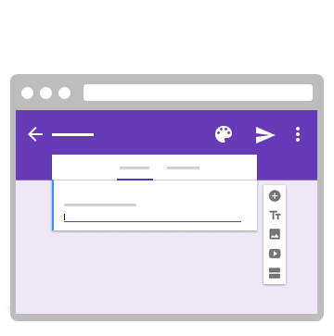
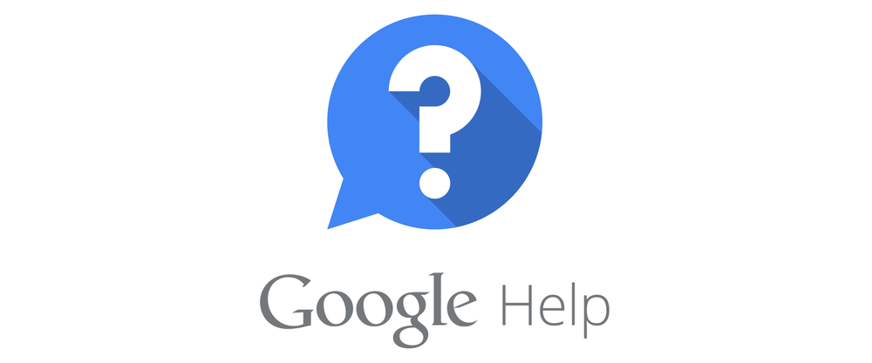
How to measure and optimize my performances?
Focus on performance monitoring: Google Help Center
Google Help Center is a tool offered by Google documenting all its tools (Google Adwords, Google Analytics ...).
These trainings are addressed to all levels from beginner to expert.
Following this training, we strongly recommend you:
Google Ads Help
Google Ads Skillshop – a lot of very nice tutorials ☺
Google Ads Certification
39

Slide 40
Thank you
for your participation!
If you have any questions, now's the time

